Slide 1

Basics of Python

Slide 2

Manishkumar R Solanki
Sr. Lecturer, Information Technology,
manish_ratilal2002@yahoo.com
SBMP

Slide 3
Students will be able to:
Declare variables in Python
Use data types appropriately as per the requirements
Apply operators in coding.

Slide 4
Let’s start with Python Basics

Slide 5
Variable
Variables don’t require declaration. However, you must initialize them before use.
Example: test=10
The above expression will lead to the following actions.
Creation of an object to represent the value 10.
If the variable (test) doesn’t exist, then it’ll get created.
Association of the variable with the object, so that it can refer the value.
The variable ‘test’ is a reference to the value ’10’. Please refer to the illustration shown below
test
10

Slide 6
The naming rules for a variable are same as C/C++.Maximum length can be of 79 characters

Slide 7
Variable
Whenever the expression changes, Python associates a new object (a chunk of memory) to the variable for referencing that value. And the old one goes to the garbage collector.
Example.
>>>test=10
>>>id(test)
1716585200
>>>test=11
>>>id(test)
1716585232

Slide 8
Variable
It’s the object which has a type, not the variable. However, a variable can hold objects of different types as and when required.
Example.
>>>test=10
>>>type(test)
<class'int'>
>>>test='techbeamers'
>>>type(test)
<class'str'>
>>>test={'Python','C','C++'}
>>>type(test)
<class'set'>

Slide 9
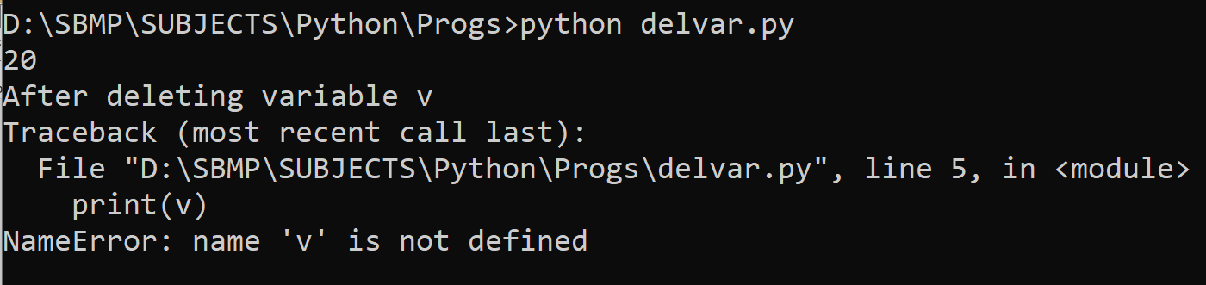
Variable
Deleting variables: We can also delete the reference to a number object by using the del statement.
del var1[,var2[,var3[....,varN]]]]
Example:
v = 20;
print(v)
del v
print("After deleting variable v")
print(v)

Slide 10
Data Types

Slide 11
Numbers
Integers:
There is as such no limit for value range for the integers.
The value range is decided by the RAM size
Example
test=999999999999999999999999999999
print("Value of test=",test)
Output
Value of test= 999999999999999999999999999999

Slide 12
Numbers
Integers: binary, octal and hexadecimal number system
Notation | Interpretation | Base | Example
0b or 0B | Binary | 2 (0-1) | print(0b101) = 5
0o or 0O | Octal | 8 (0-7) | print(0O10) =8
0x or 0X | Hexadecimal | 16 (0-F) | Print(0x25)=37

Slide 13
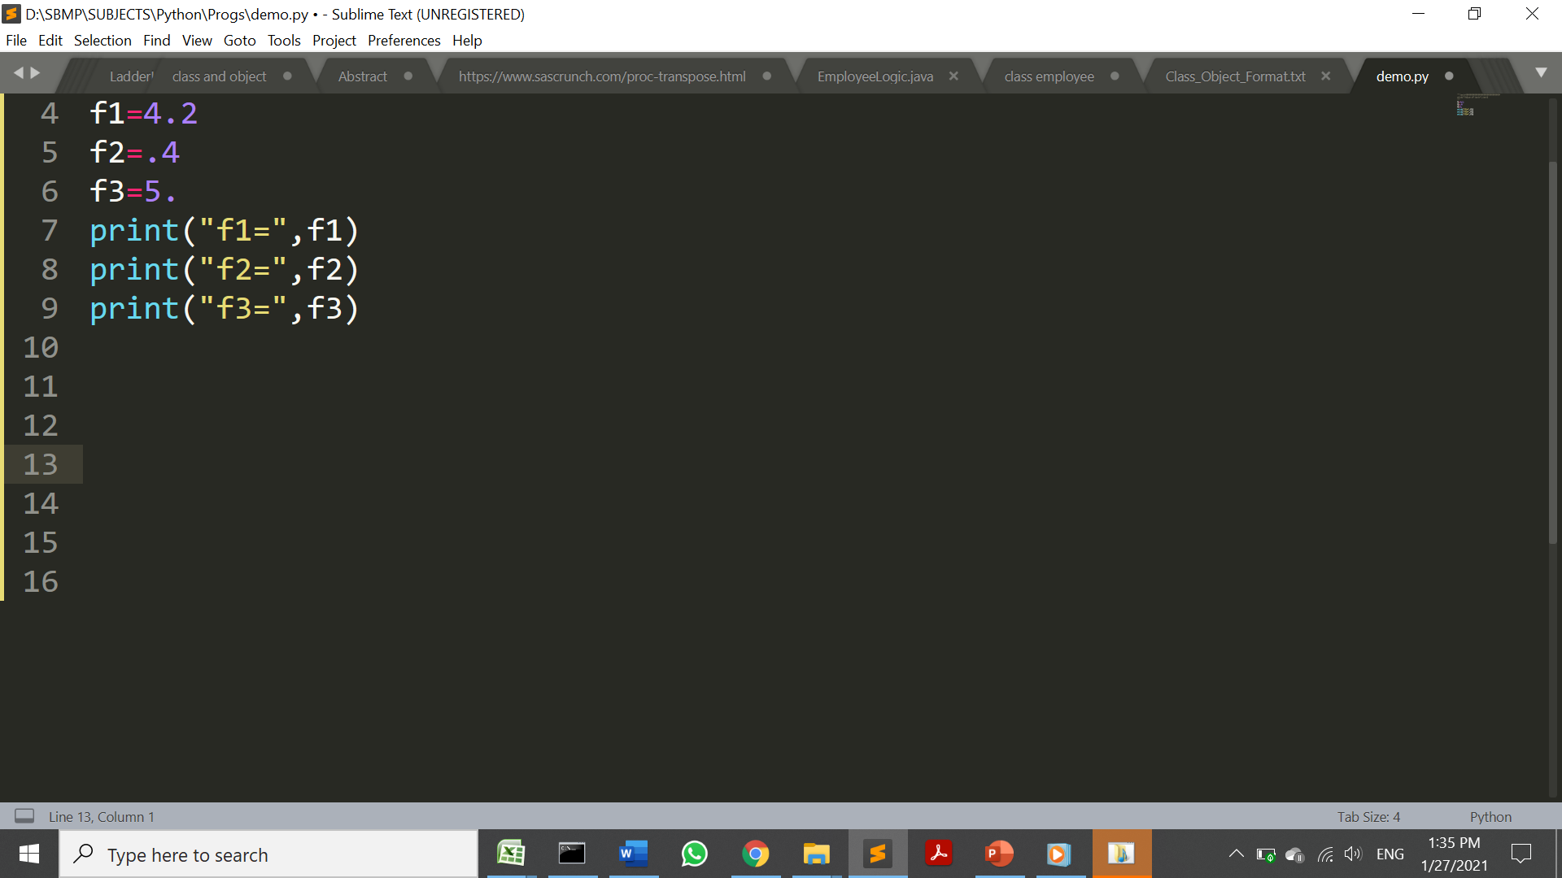
Numbers
Floating Point:
The float type in Python designates a floating-point number.
float values are specified with a decimal point..
Example
Output
f1= 4.2
f2= 0.4
f3= 5.0

Slide 14
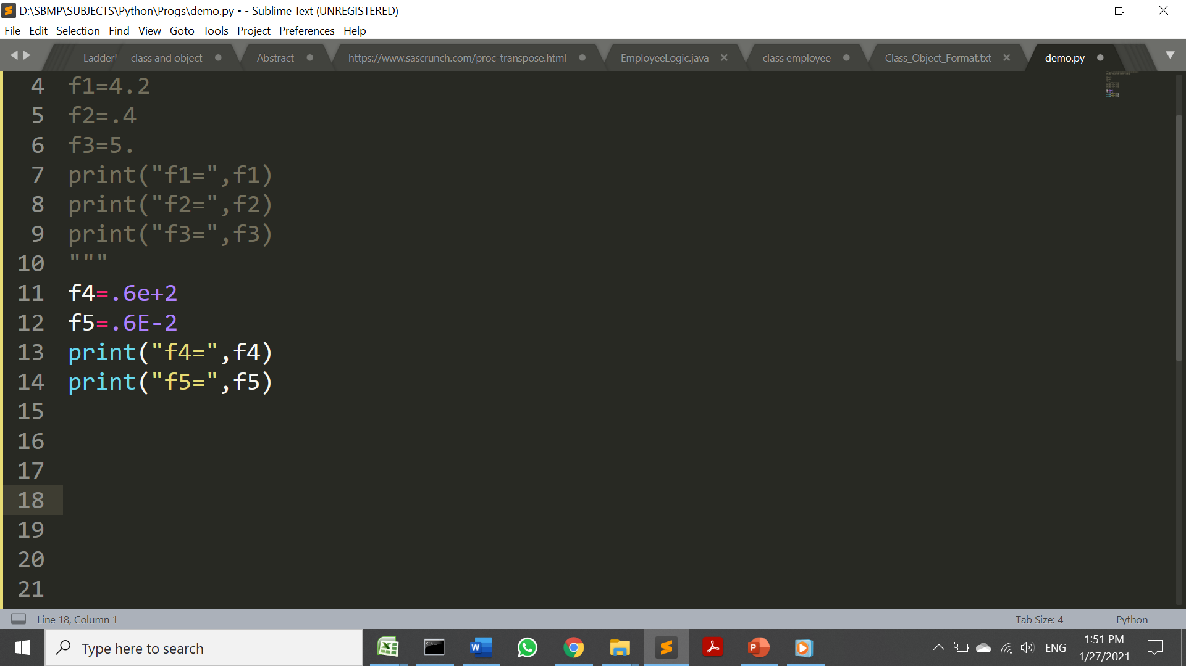
Numbers
Floating Point: Scientific Notation
The character e or E followed by a positive or negative integer may be appended to specify scientific notation:
Example
Output
f4= 60.0
f5= 0.006

Slide 15
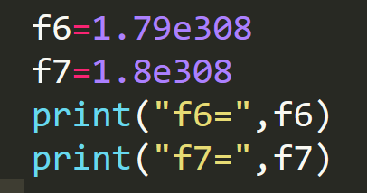
Numbers
Floating Point: Scientific Notation
Almost all platforms represent Python float values as 64-bit “double-precision” values, according to the IEEE 754 standard.
The maximum value a floating-point number can be approximately 1.8 ⨉ 10³⁰⁸
A number greater than is represented as string inf:
Example
Output
f6= 1.79e+308
f7= inf

Slide 16
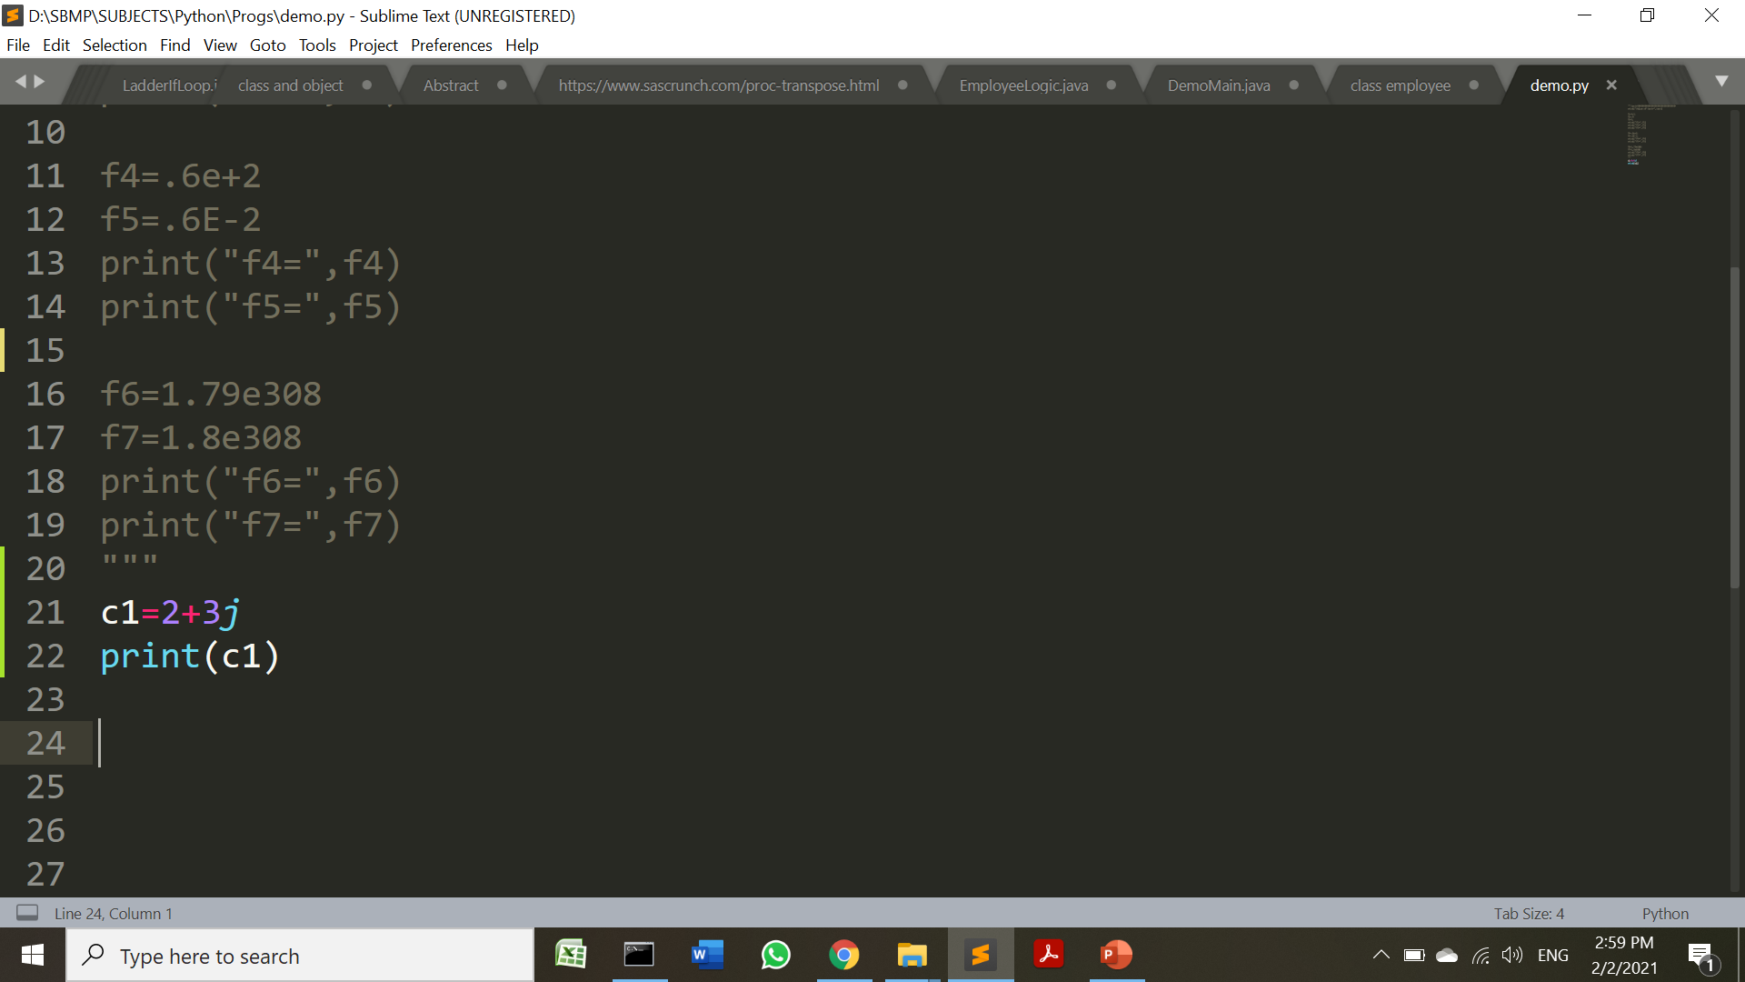
Numbers
Complex Numbers
Complex numbers are specified as <real part>+<imaginary part>j. For example:
Example
Output
(2+3j)
Note: Complex number can be denoted as complex(x,y) also
c1.real gives real part and c1.imag gives imaginary part

Slide 17
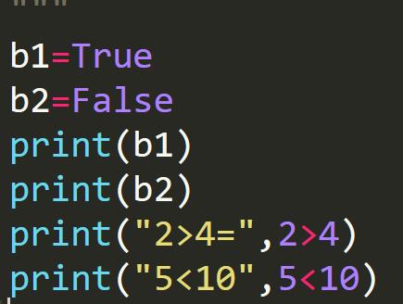
Boolean
Python 3 provides a Boolean data type. Objects of Boolean type may have one of two values, True or False.
Example
Output
True
False
2>4= False
5<10 True

Slide 18
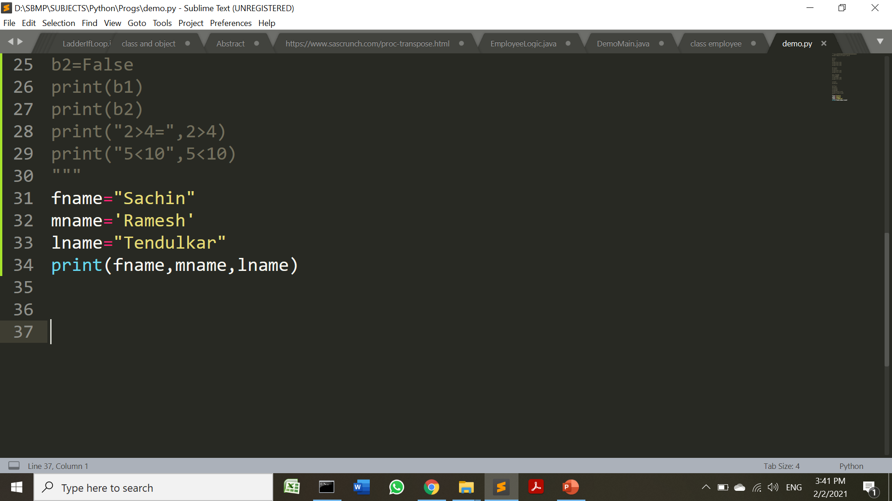
String
In python, string can be represented in either ‘ ’ or in “ ”.
A string in Python can contain as many characters as you wish. (limit is your machine’s memory)
A string can also be empty:
Example
Output
Sachin Ramesh Tendulkar

Slide 19
String
In python, string can be represented in either ‘ ’ or in “ ”.
A string in Python can contain as many characters as you wish. (limit is your machine’s memory)
A string can also be empty:
Example
Output
Sachin Ramesh Tendulkar

Slide 20
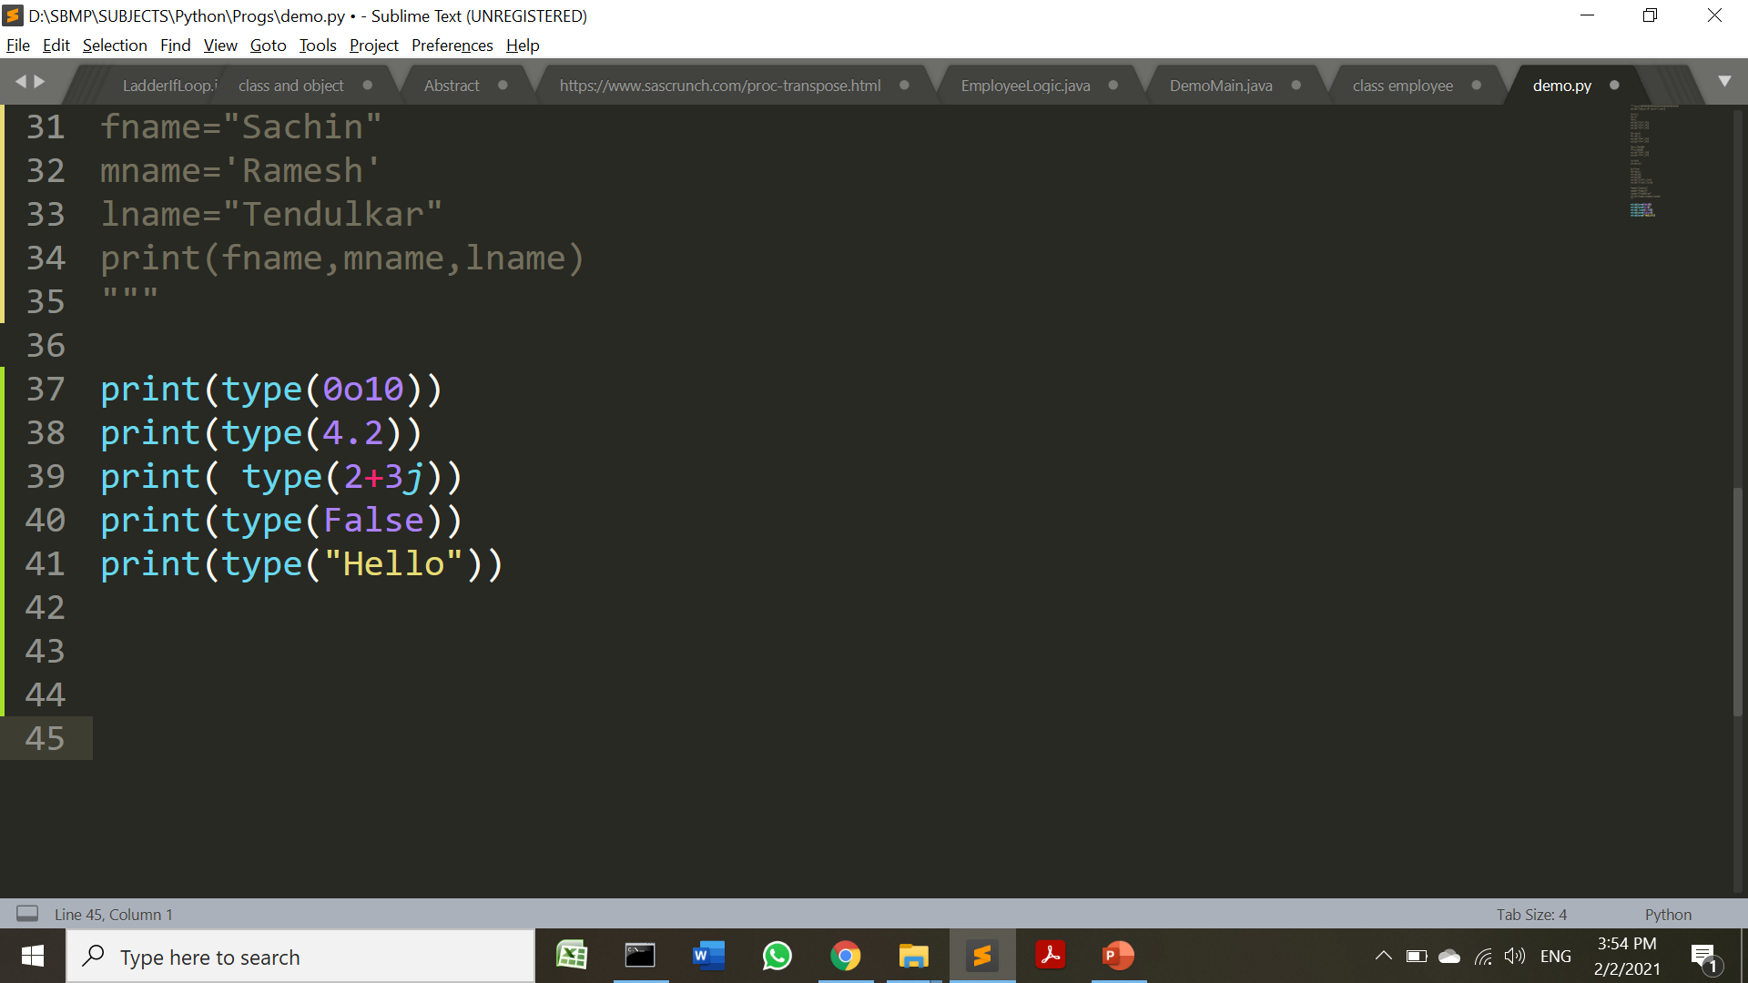
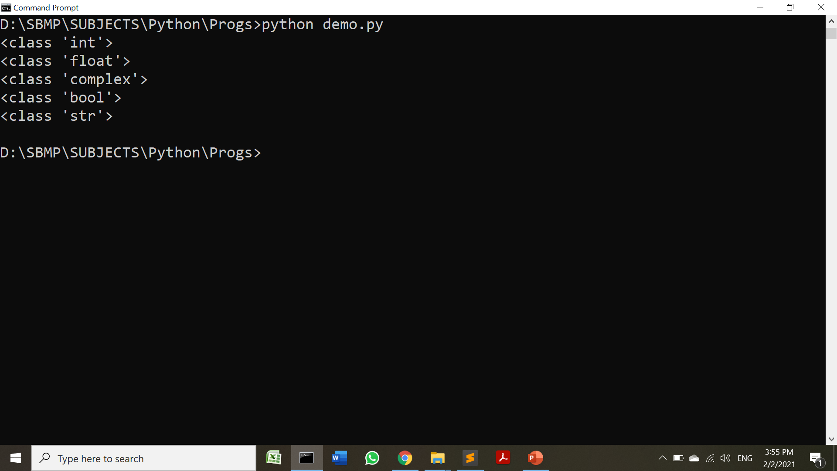
type() function
type() method returns class type of the argument(object) passed as parameter.
type() function is mostly used for debugging purposes.
Example
Output

Slide 21
type() method returns class type of the argument(object) passed as parameter. type() function is mostly used for debugging purposes.

Slide 22
Lists, Tuples ,Dictionary and Set
Lists, Tuples ,Dictionary and Set will be discussed in Unit No.3

Slide 23
Comments
Single line comment is written using ‘#’
# Hello World Program
Multiple line comments
# Hello World Program
# Using Multiline Comments
A string literal not assigned to any variable
‘Hello Comment’
Multiline comment using string literal
'''
I am a
multiline comment!
'''

Slide 24
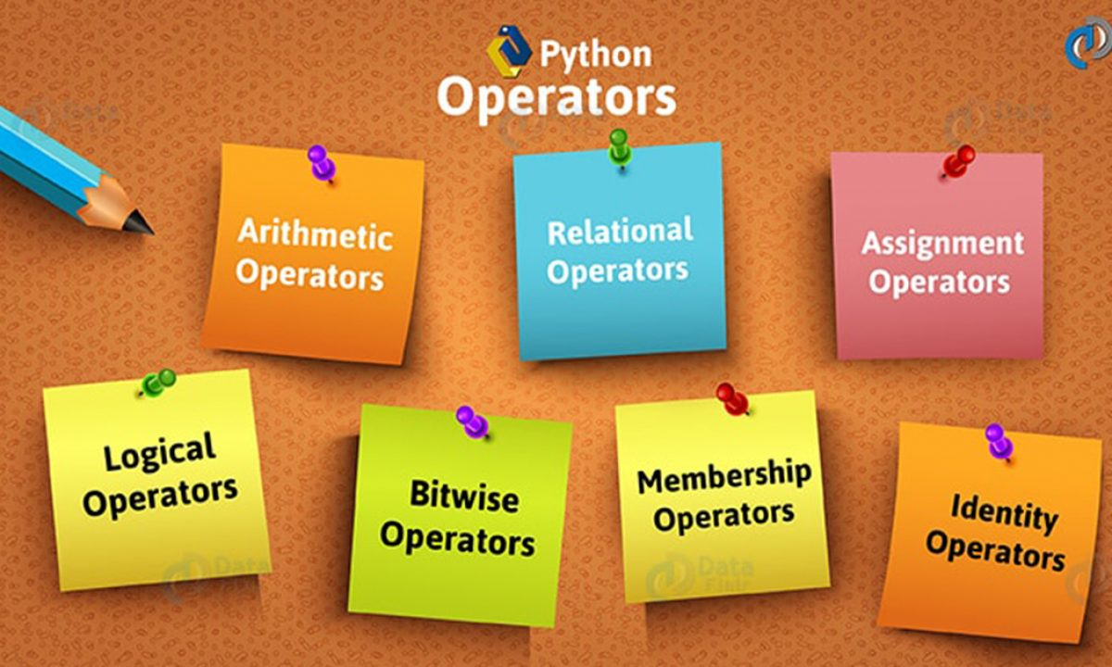

Slide 25
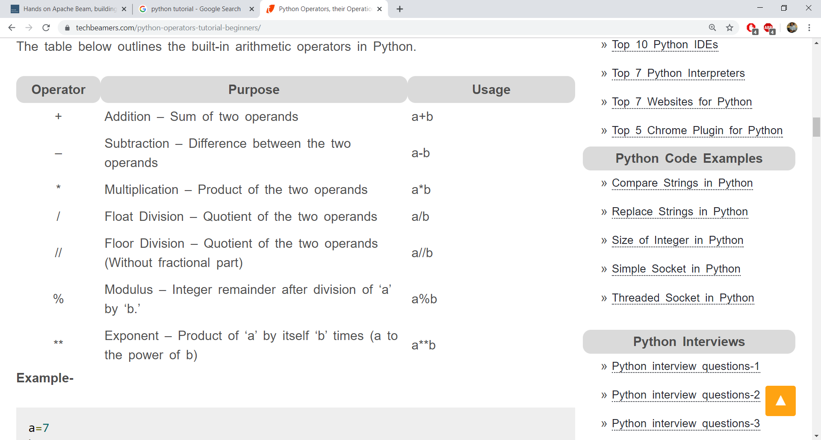
Arithmetic Operators

Slide 26
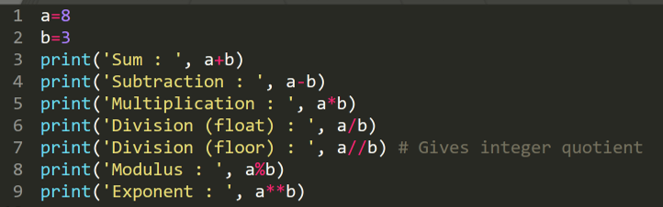
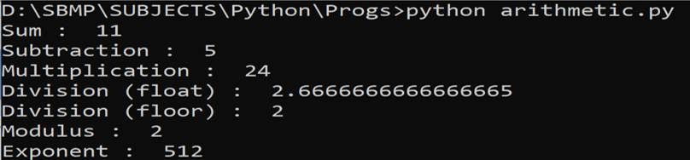
Arithmetic Operators

Slide 27
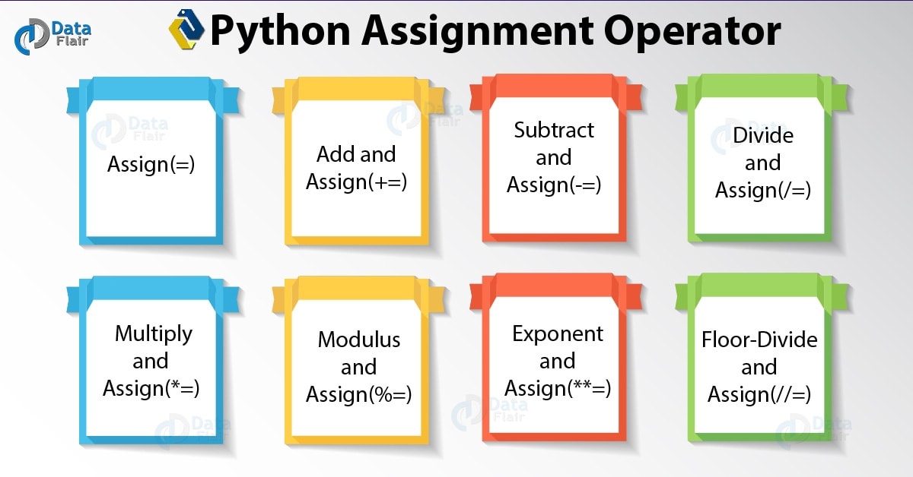
https://data-flair.training/blogs/python-operator/

Slide 28
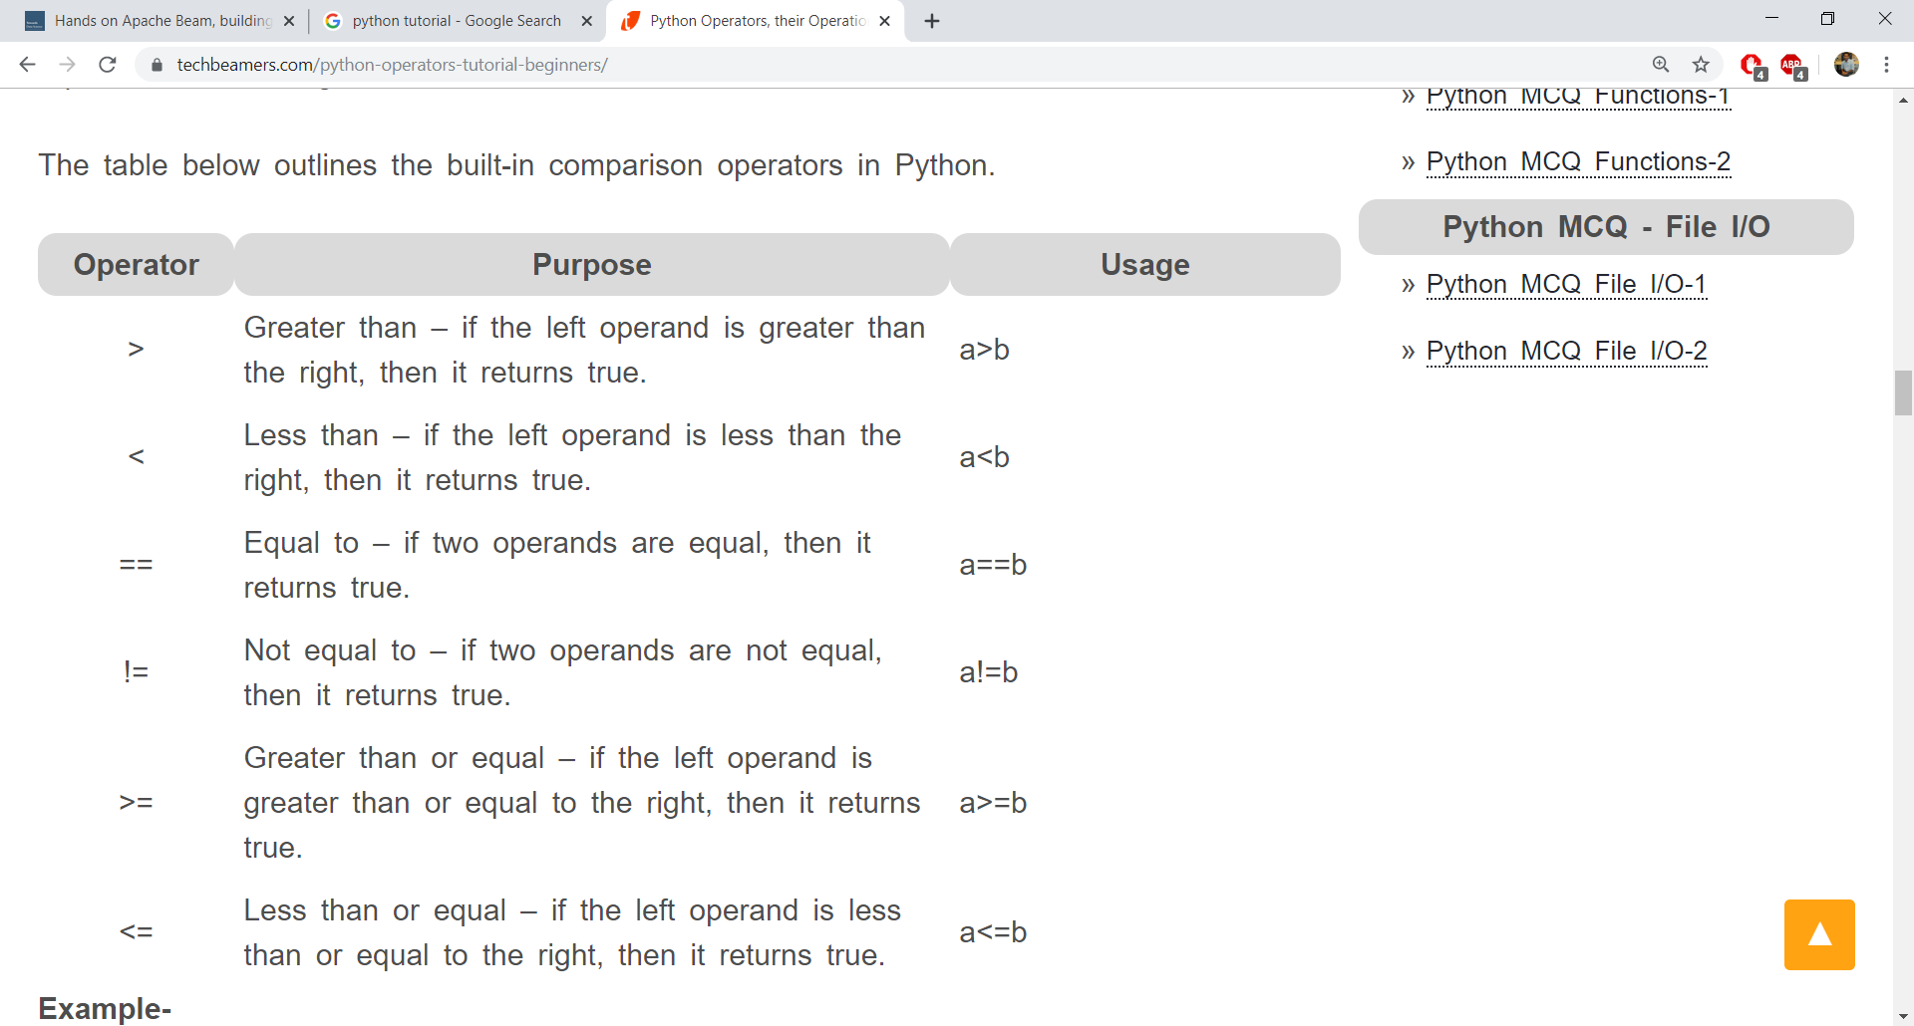
Relational(Comparison) Operators

Slide 29
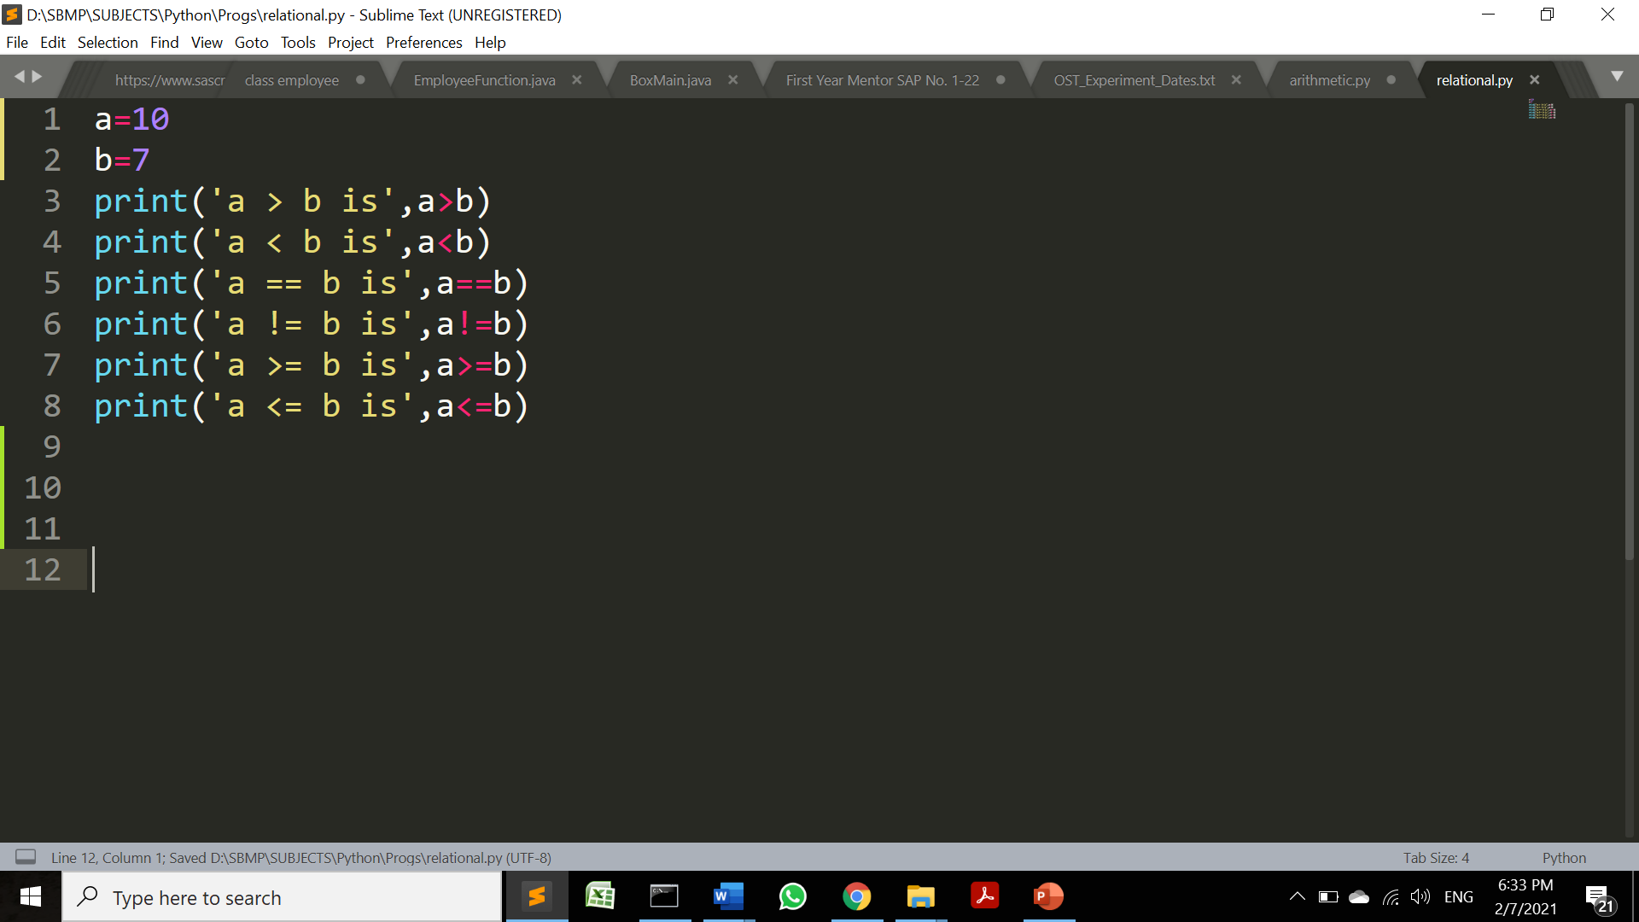
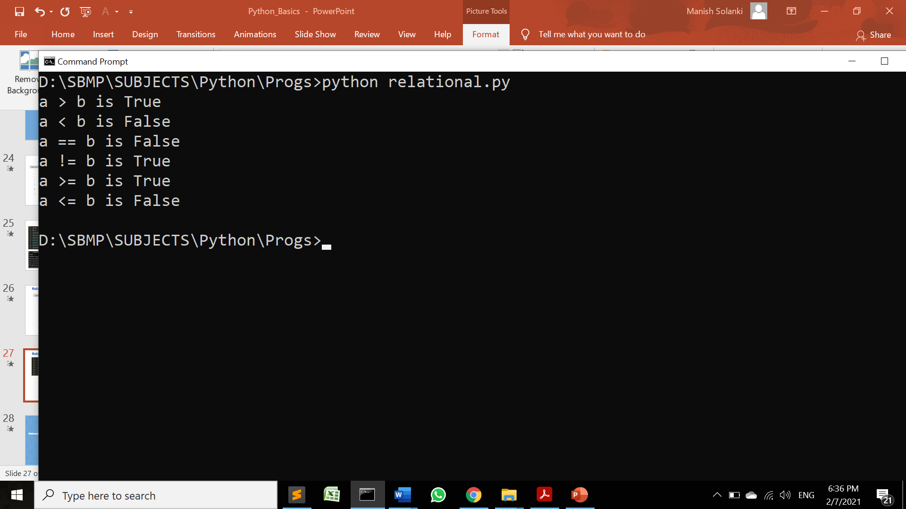
Relational(Comparison) Operators

Slide 30
Logical Operators
Logical operators in Python are AND, OR and NOT.
For AND operator – It returns TRUE if both the operands (right side and left side) are true
For OR operator- It returns TRUE if either of the operand (right side or left side) is true
For NOT operator- returns TRUE if operand is false

Slide 31
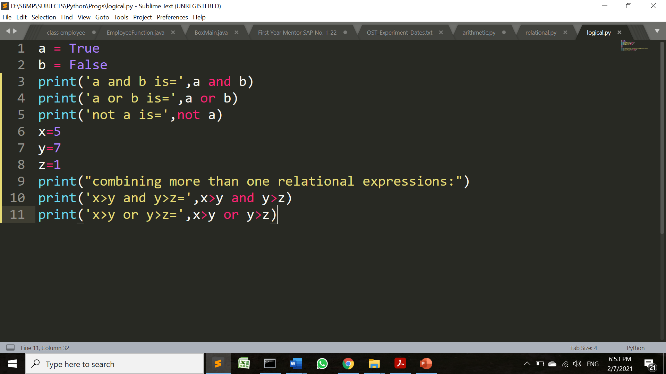
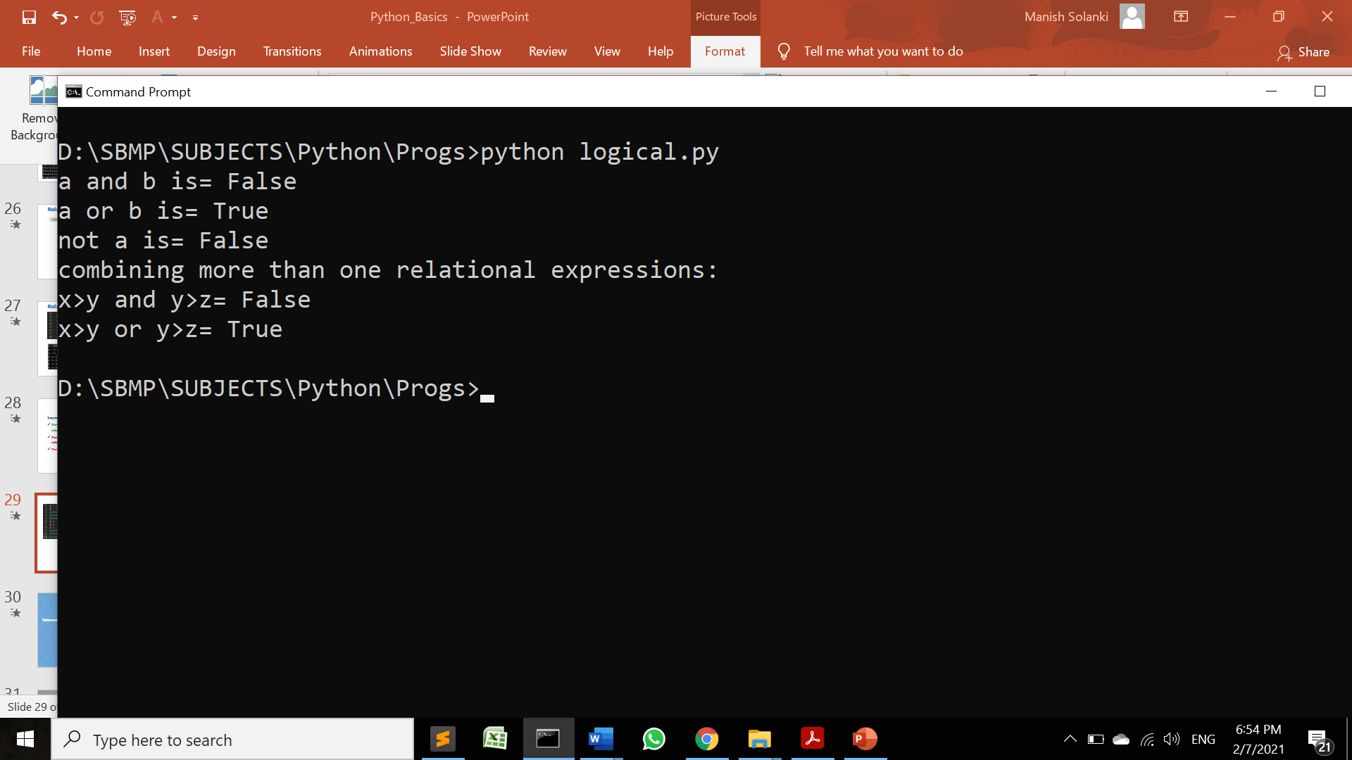
Logical Operators
https://www.guru99.com/python-operators-complete-tutorial.html

Slide 32
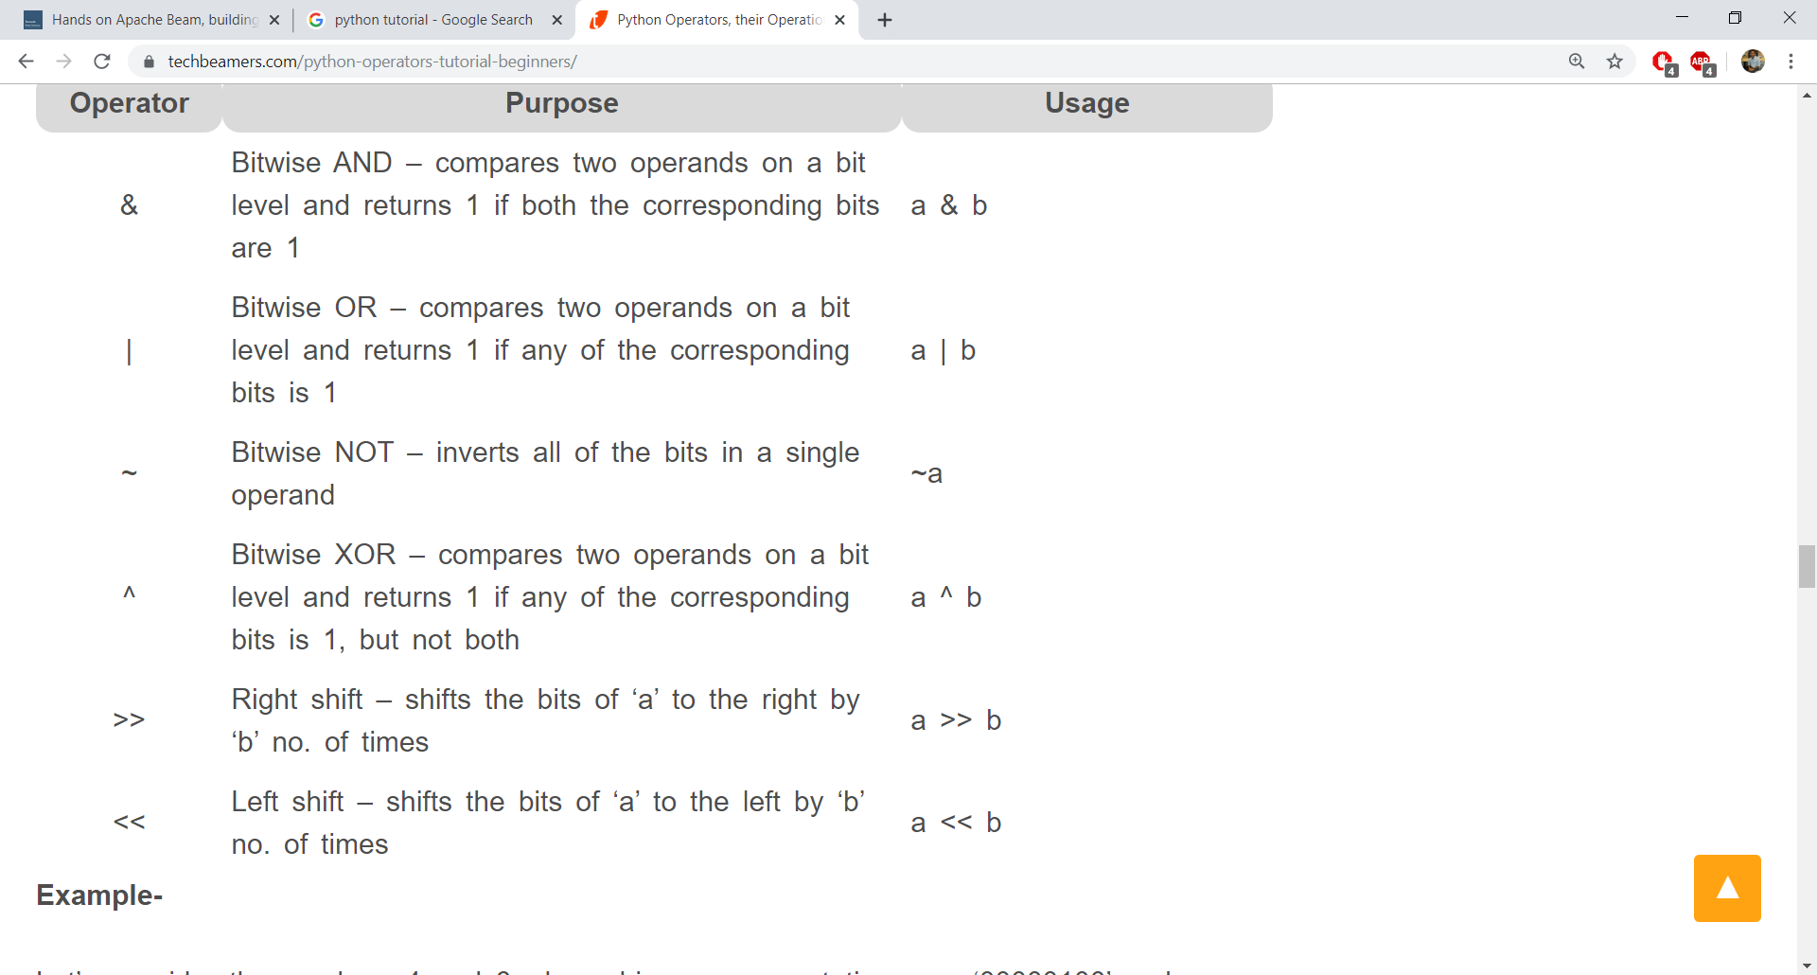
Bitwise Operators

Slide 33
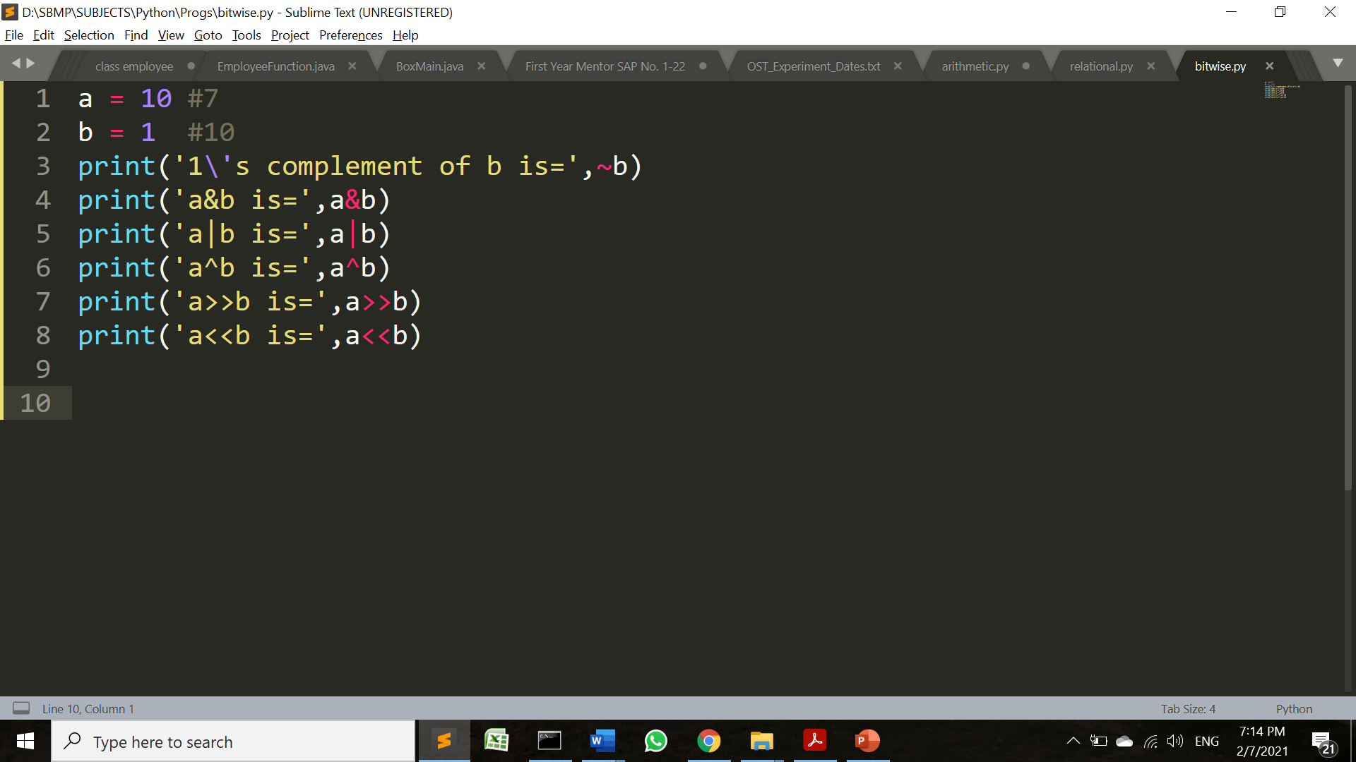
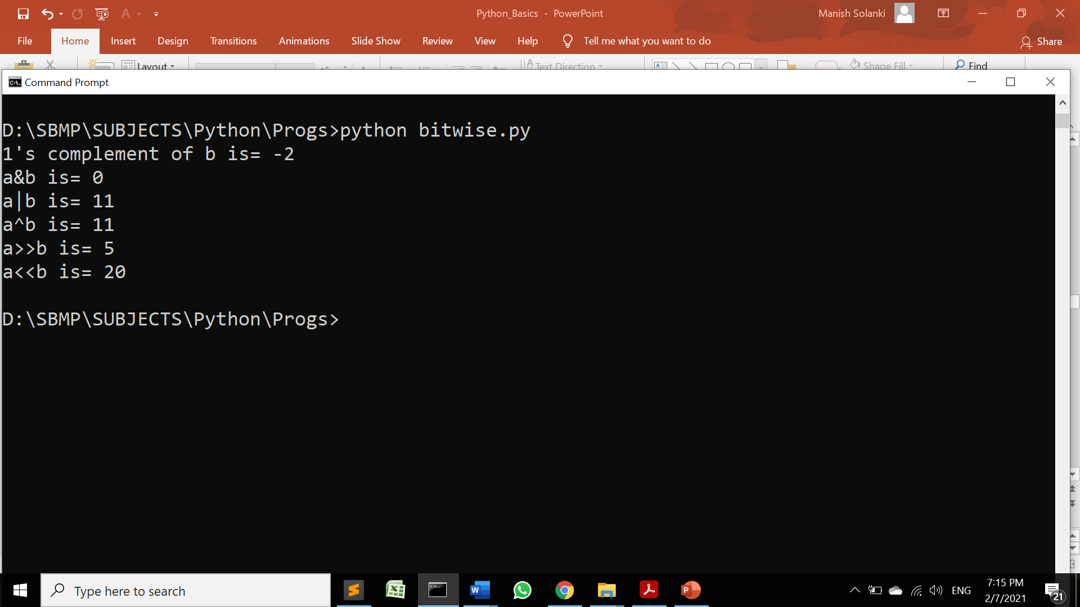
Bitwise Operators

Slide 34
Identity Operators
Enable us to compare the memory locations of two Python objects/variables.
Are used to check two objects share the same memory address or not.
The variables holding equal values are not necessarily identical.
We can also use these operators to determine whether a value is of a specific class or type

Slide 35
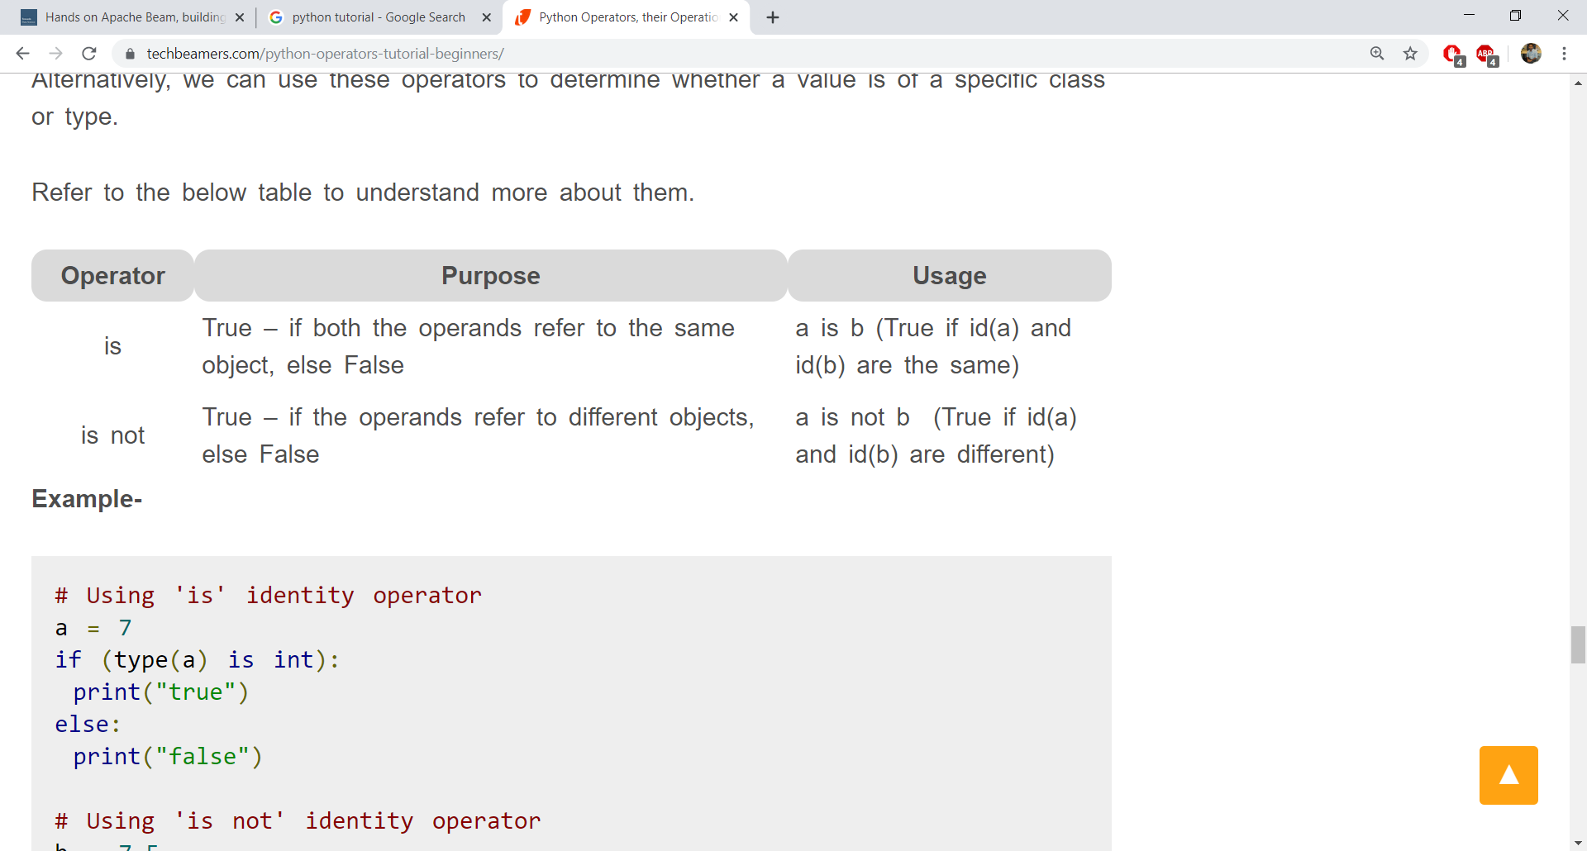
Identity Operators

Slide 36
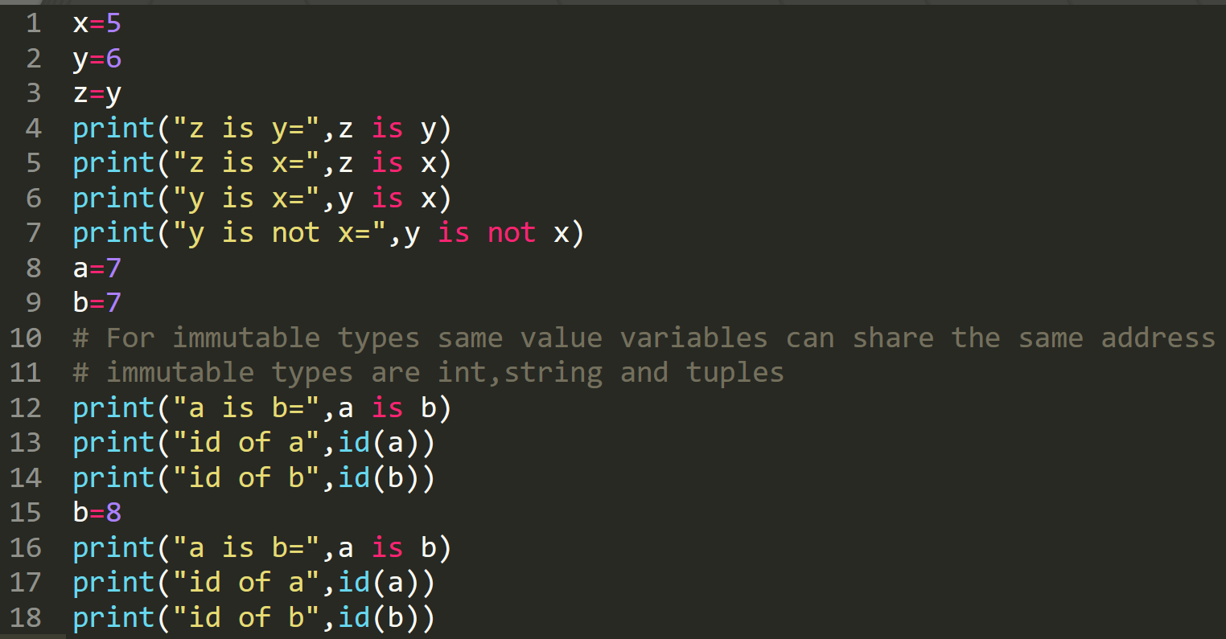
Identity Operators

Slide 37
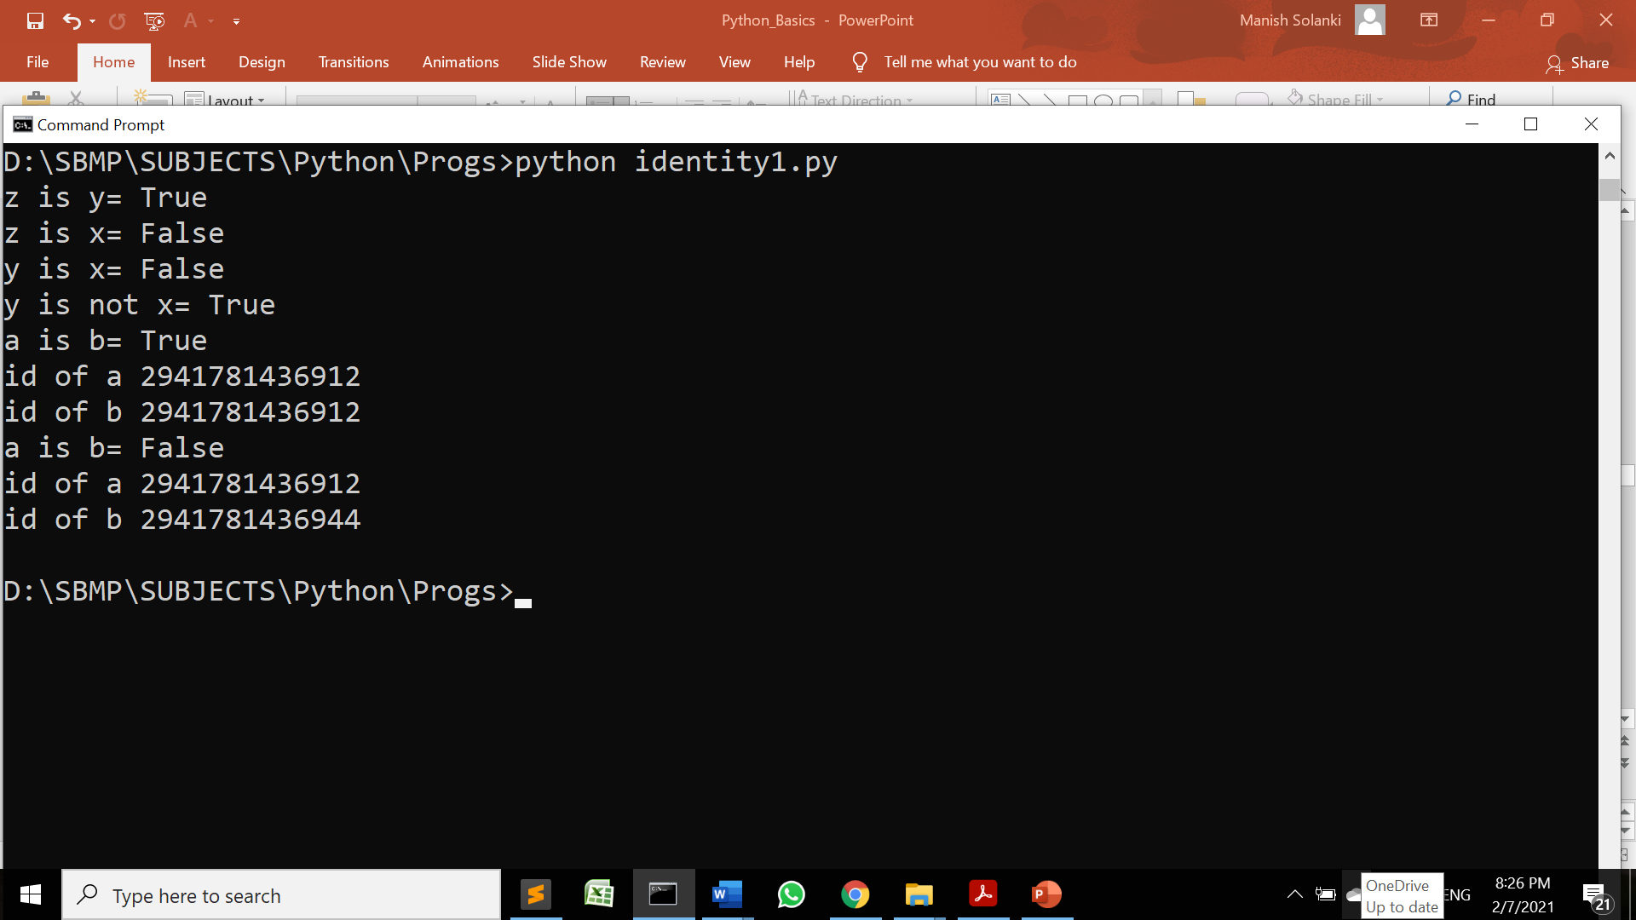
Identity Operators

Slide 38
Python uses caching to save memory space and improve performance.
Variables having same value may share the same address (id). = Caching
Caching can work only with immutable objects, i.e. integer, string, tuples.

Slide 39
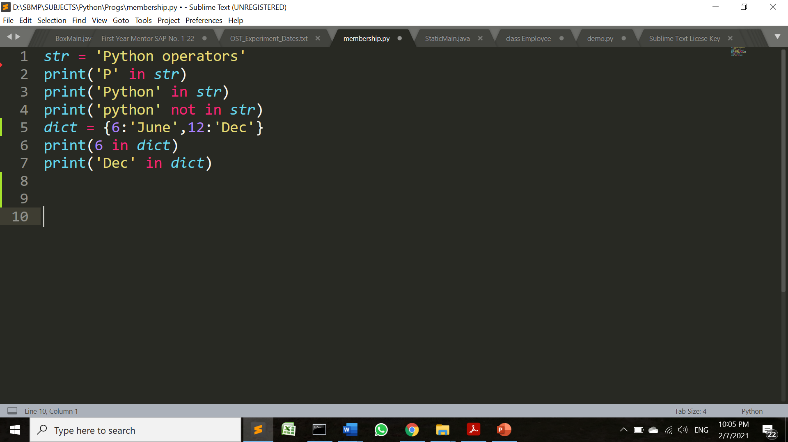
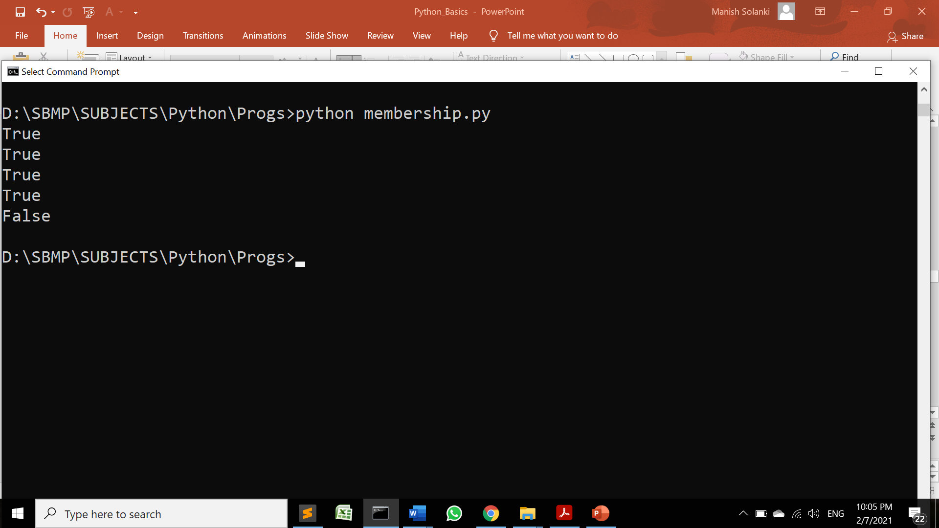
Membership Operators
Enable us to test whether a value is a member of other Python objects such as strings, lists, or tuples.
Can also test against a dictionary but only for the key, not the value.

Slide 40
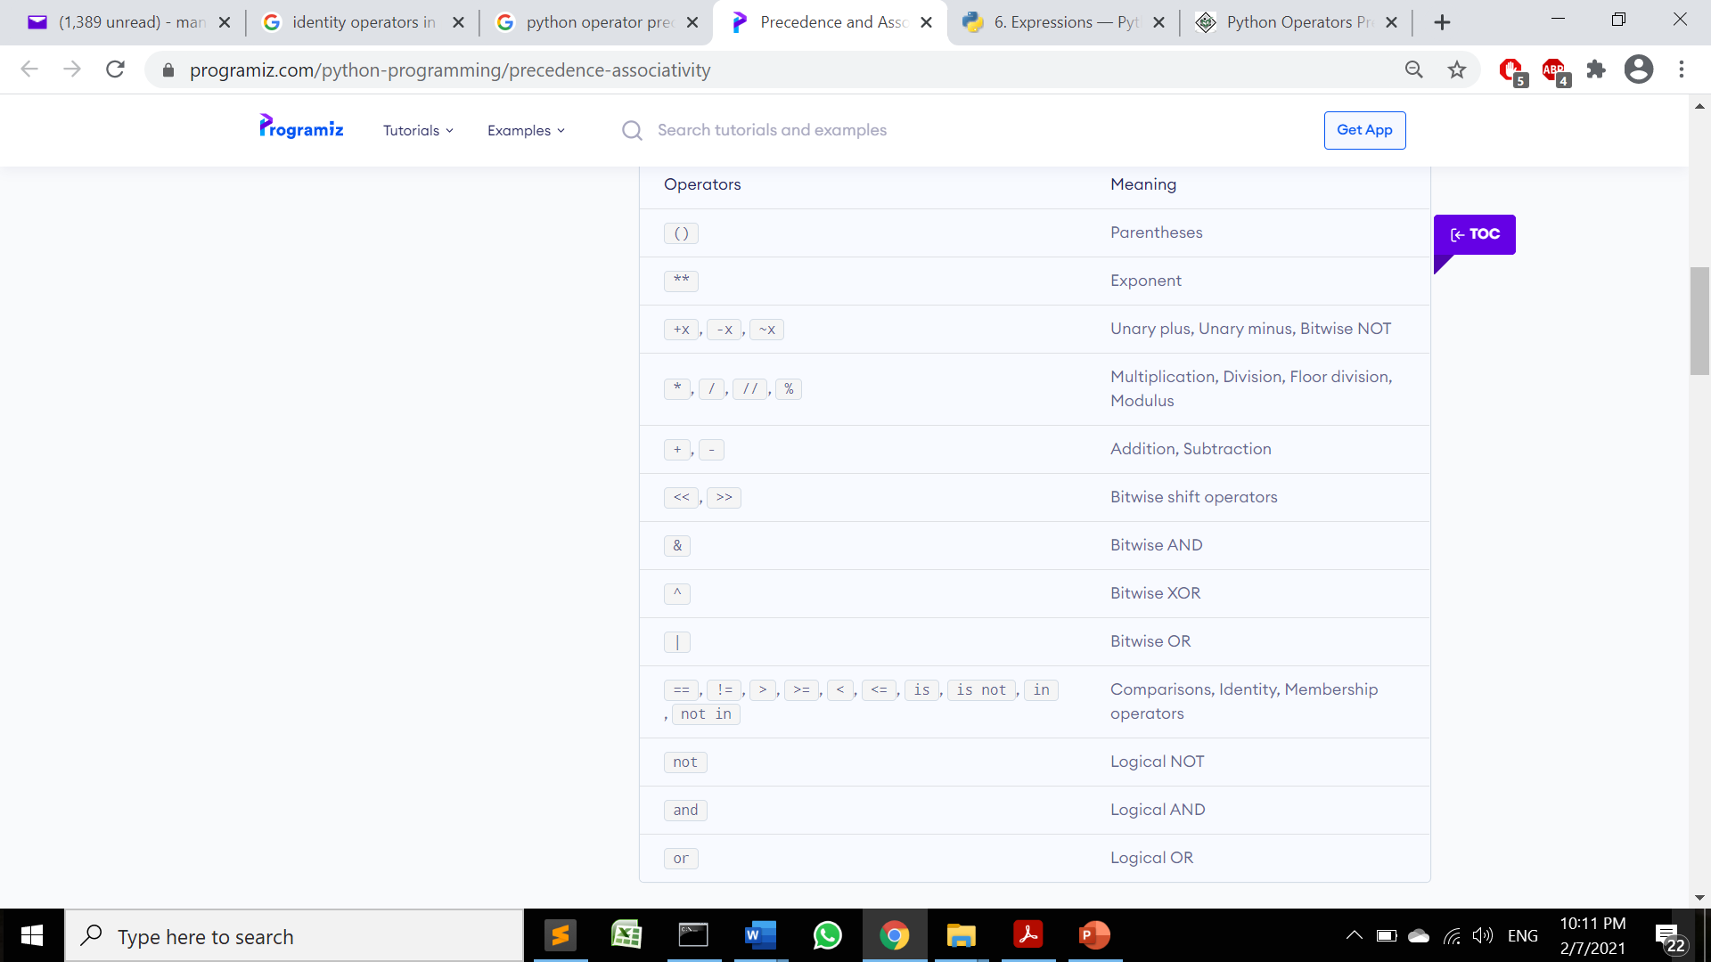
Operator Precedence
https://www.programiz.com/python-programming/precedence-associativity

Slide 41
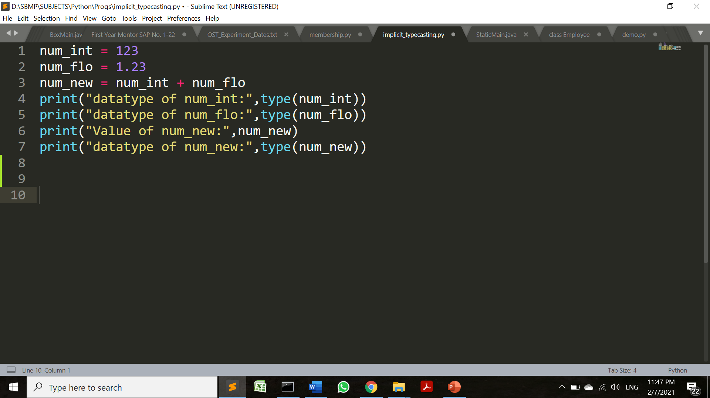

Type Conversion(Casting)
Implicit Type Casting

Slide 42
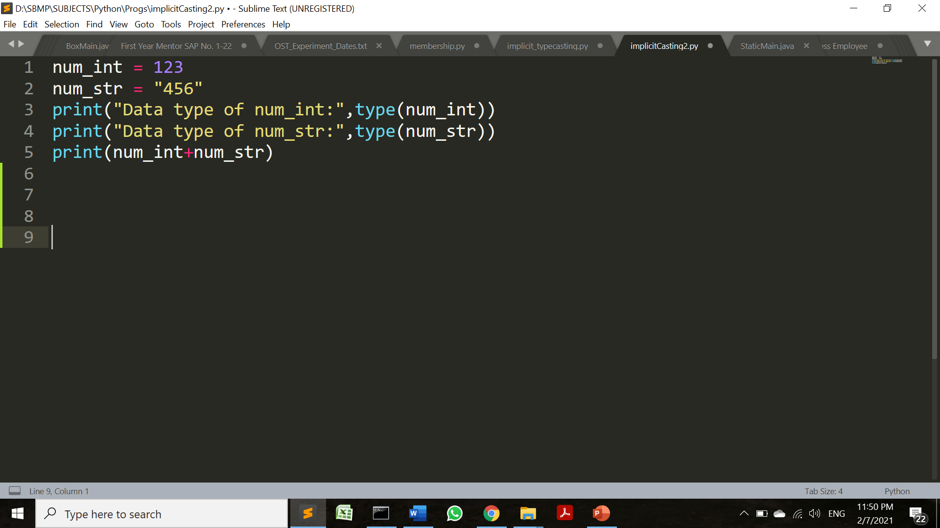
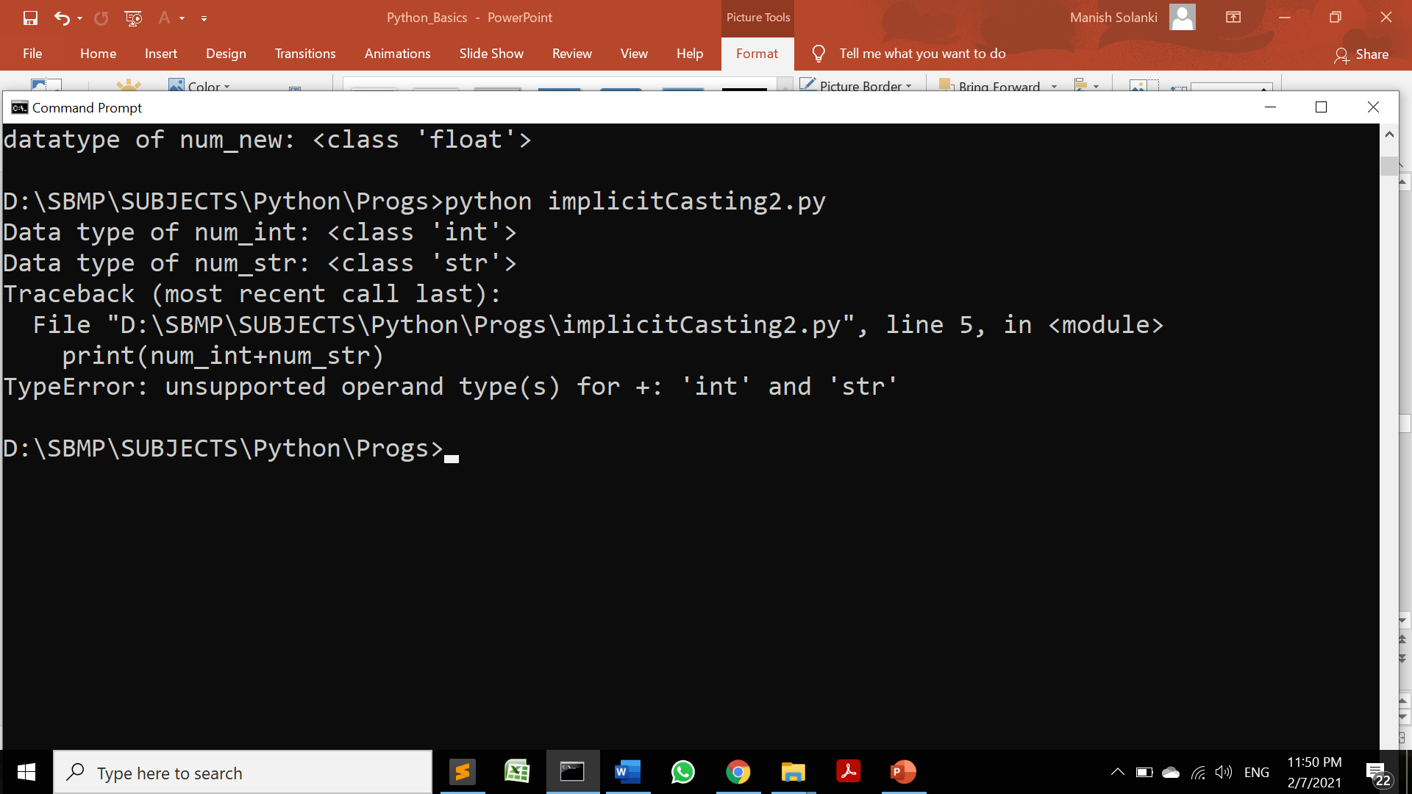
Type Conversion(Casting)
Implicit Type Casting(incompatible types)

Slide 43
Type Conversion(Casting)
Explicit Type Casting:
In Explicit Type Conversion, users convert the data type of an object to required data type.
Syntax: <required_datatype>(expression)
Predefined functions like int(), float(), str(), etc are used to perform explicit type conversion.

Slide 44
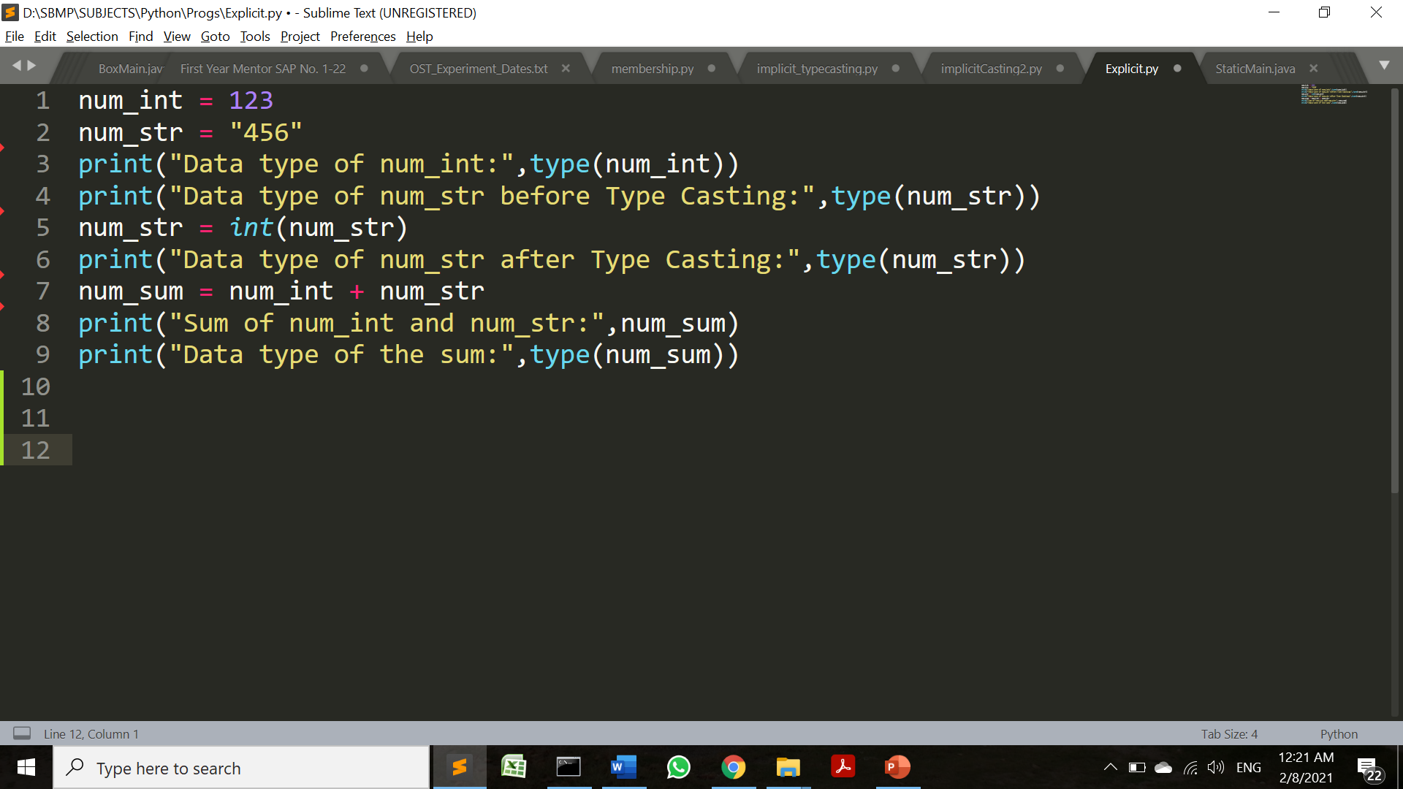
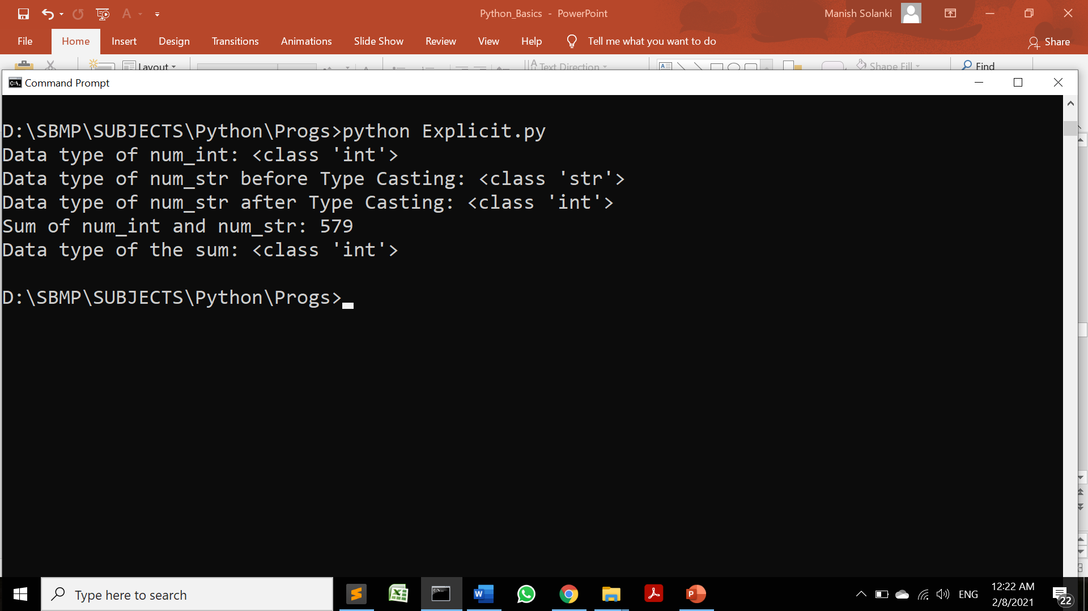
Type Conversion(Casting)
Explicit Type Casting:

Slide 45
References
https://realpython.com/python-data-types/
https://www.guru99.com/python-operators-complete-tutorial.html
https://data-flair.training/blogs/python-operator/ (python operator image)
https://www.programiz.com/python-programming/

Slide 46
THANKS!
Any questions?
You can find me at
manish_ratilal2002@yahoo.com

